Slide 1

Twitter User Gender Classification
Project Presentation by:
Akshay Karki & Sahana Murthy

Slide 2

Content
Introduction
Data Cleaning
Feature Selection and Extraction
Algorithms used
Results (Accuracy of each model)
Results (Using Confusion matrix)
Discussion
Conclusion
Analysis

Slide 3
Introduction
Importance of Social Media Analysis
What we tried to achieve
Data set we used
Analysis on our results

Slide 4
Data cleaning
Cleaning methods:
Null observations
Empty target values
‘Unknown’ gender
Text Processing:
Convert text to lower case, remove special characters, whitespaces, digits etc.,
Filter data based on Gender Confidence

Slide 5
Feature selection and extraction
Data set is split into training and testing sets using only profile description and then only tweets.
Combine 2 attributes to form a feature.
Choose 5 attributes, then choose 4 and so on.
Use of countVectorizer and LabelEncoder.

Slide 6
Algorithms used
Use 7 classification algorithms to classify given data.
Implemented using scikit-learn library in Python.
Computing accuracy of each classifier.
Building the confusion matrix.

Slide 7
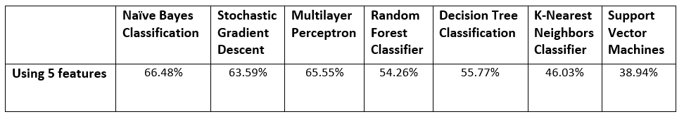

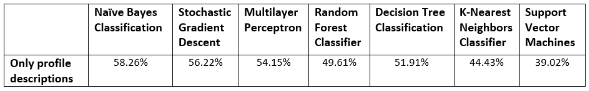
Results (Accuracy of each model)
Used 5 different approaches on each classifier.
Naïve Bayes classifier performs the best while Support Vector Machines perform the worst.
Multilayer Perceptron Classifier takes the longest time.

Slide 8
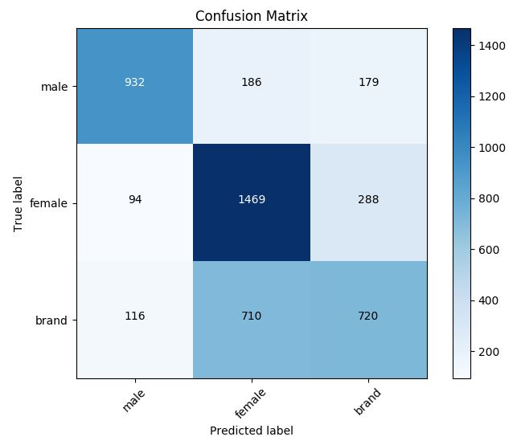
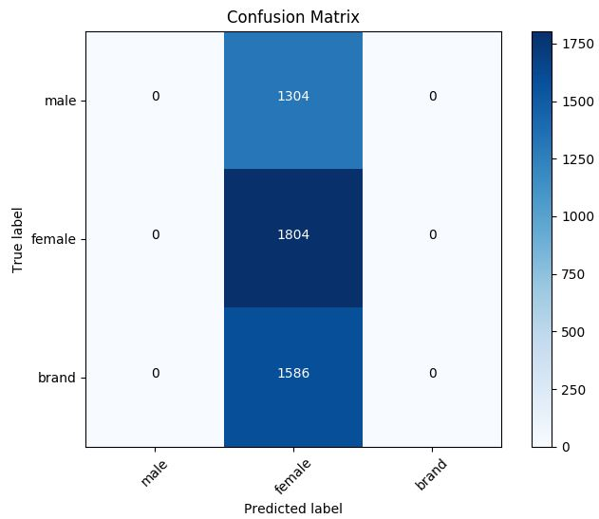
Results (Using confusion matrix)
Naïve Bayes achieves highest number of correctly classified instances while SVM has the lowest.
For the 4 feature approach, Decision Tree has the second best count for Female gender while Multilayer Perceptron has the second best count for Male gender and Brands.

Slide 9
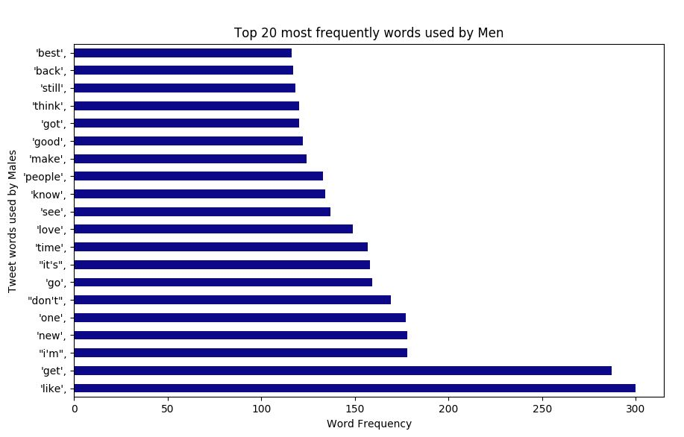
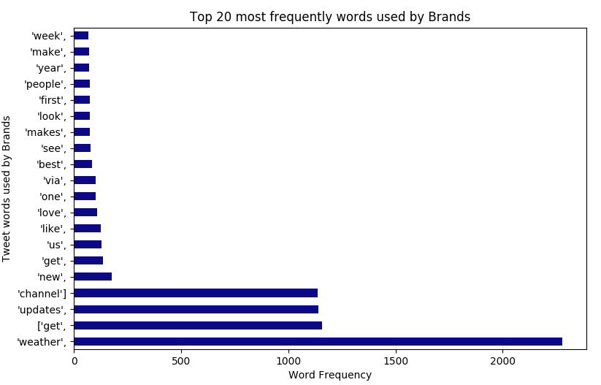
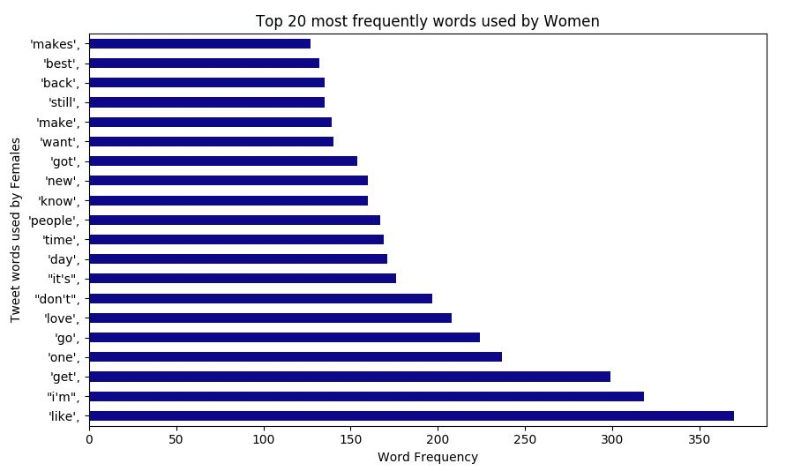
Analysis
Use NLTK ‘stopwords’ library for text processing
After removing stop-words, retrieve list of top 20 most frequently used words
Shows us which words might be used more by which gender while tweeting.

Slide 10
Discussion
Most interesting part about project
Problems faced
What we learned
The bigger picture

Slide 11
Conclusion
Classifying gender based on user profile attributes.
Use 7 classifier models to train and test on our data
Perform text analysis to determine most frequently used words in tweets.
Using usernames, number of tweets, hashtags could lead to interesting results.
Implementing our algorithms could be considered future work.

Slide 12
Thank you!

